Slide 1
MedSegDiff: Medical Image Segmentation with Diffusion Probabilistic Model
Junde Wu, Huihui Fang, Yu Zhang, Yehui Yang, Yanwu Xu
Proceedings of the IEEE/CVF Conference on Computer Vision and Pattern Recognition (CVPR), 2022
2022. 11. 20
김준철, 김병현, 박재완, 이희재, 조경진, 최재규

Slide 2
Contents
Background
Introduction
Method
Experiments
Conclusion

Slide 3
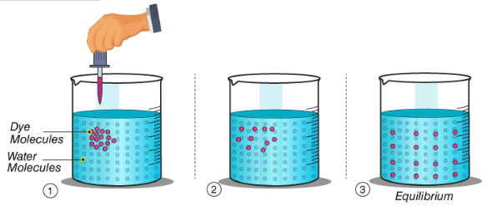
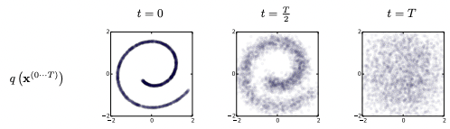

Background Diffusion
In thermodynamics
In statistics
High Density -> Low Density -> Equilibrium
Equilibrium 상태에서 High Density 로 모델이 학습할 수 있을까?

Slide 4
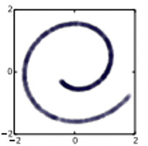
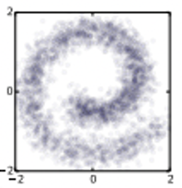
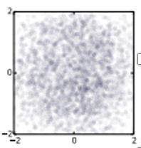
Background Diffusion Probabilistic Models
궁금증 : Diffusion 모델이 왜 잘되는가?
Deep Unsupervised Learning using Nonequilibrium Thermodynamics (2015 PMRL)
=> 결론 : 통계적 근사를 더 정확하게 구현하였다.
첫 번째 아이디어 : Sequential Monte Carlo – Marcov Chain
-> 연속적 확률을 근사화
두 번째 아이디어 : Non-equilibrium statistical physics
-> 통계적 수식의 원천
Markov stochastic process
미래의 상태는 과거에 의존하지 않고 현재 상태에 대해서만 영향을 받는다. (연산의 단순화 + 근사화)
근사화로 인한 정확도 하락을 어떻게 커버 할 것인가?
- Ideal case
- With Markov stochastic process

Slide 5
Background Diffusion Probabilistic Models
두 번째 아이디어 : Non-equilibrium statistical physics
Quasi-static processes (준정적 과정)
- 매우 천천히 변하여 각 순간마다 평형상태로 간주 할 수 있는 이상적인 과정
…
…
t = 0
t = 1
t = T/2
t = T
Noise가 추가되었지만 변화가 거의 없는 상태
각 순간의 변화과정이 거의 없는 상태로 구현 할 수 있다면 과거에 대한 의존성이 낮게 가져갈 수 있음
마지막으로 수 많은 단계로 이루어진 과정을 수식적으로 표현하는 단계가 필요함

Slide 6




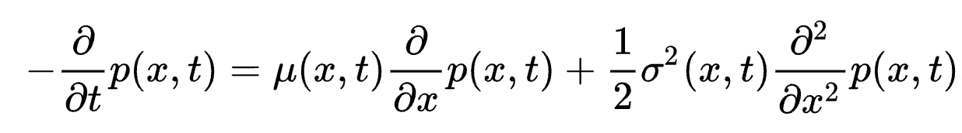
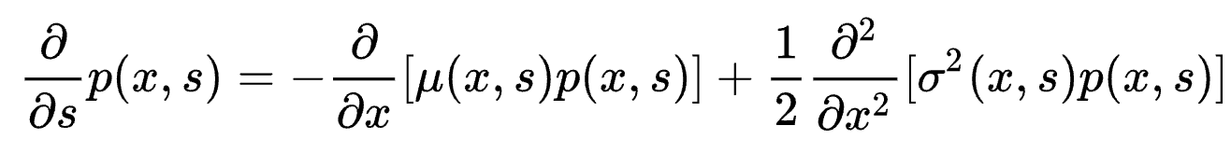
Background Diffusion Probabilistic Models
두 번째 아이디어 : Non-equilibrium statistical physics
- Langevin dynamics : In a real world molecular system
: F = ma, : the particle interaction potential, : damping factor Gaussian Process
- Kolmogorov forward and backward equation : stochastic differential equation (Marcov process 일때 스텝별 Diffusion 표현식)
- Kolmogorov backward equation (diffusion) , Fokker-Planck equation
- Kolmogorov forward equation
각 스텝 별 Noise를 Gaussian Noise로 적용

Slide 7




Background Diffusion Probabilistic Models
Transformation - T:Rd→Rd
Markov Chain, Stationary Distribution
By defining T to be repeated application of the transition kernel q(x|x’)
Stationary Distribution
- In practice, keep the iterations to a sufficiently large finite number t = T
Gaussian Diffusion = Forward Trajectory
(from Kolmogorov backward equations)
Bt = Diffusion rate
Beta 값이 매우 작다면 Diffusion 과정에서 gaussian noise를 추가하는 분포와 모델이 noise를 걷어내는 분포가 매우 유사해짐
: Markov diffusion kernel

Slide 8
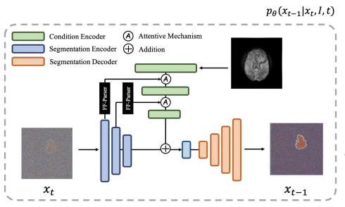
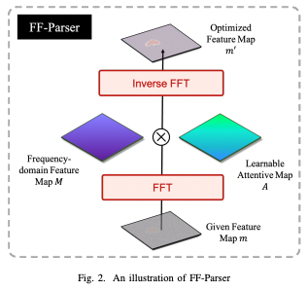
Introduction Structure
Dynamic Conditional Encoding
FF-Parser
1. We propose the first DPM based model toward general medical image segmentation tasks.
2. We propose dynamic conditional encoding, which establishes the state-adaptive conditions for each sampling step
3. We propose Feature Frequency Parser (FF-parser) to eliminate the negative effect of high-frequency noise component
4. SOTA performance on three different medical segmentation tasks with different image modalities

Slide 9

Method
01 Dynamic Conditional Encoding
02 FF-Parser

Slide 10
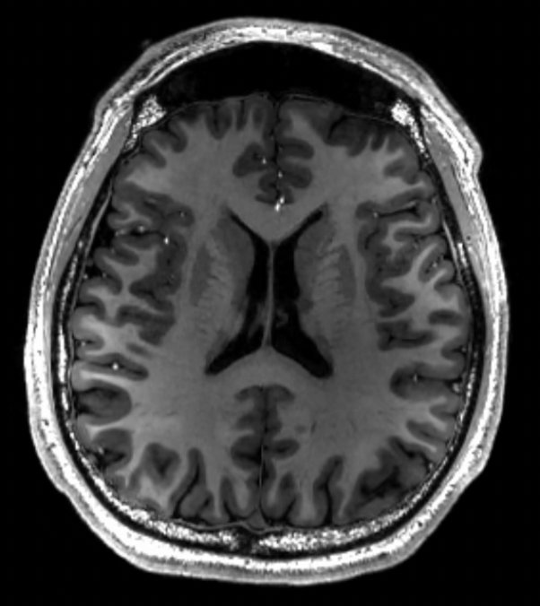
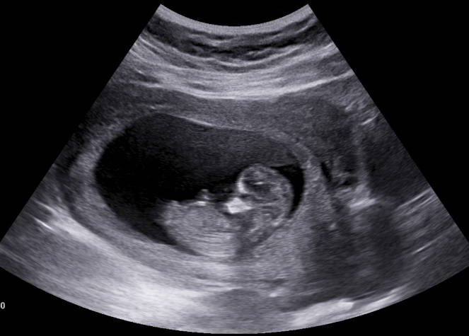
Method Dynamic Conditional Encoding
Problems of Medical Image Segmentation on DPM process
- In most conditional DPM, the conditional prior will be a unique given information
- Howerer, In medical image segmentation task is notorious for its ambiguous objects
(The lesions or tissues are often hard to discriminate from its background)
MRI
UltraSound

Slide 11
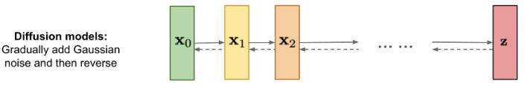

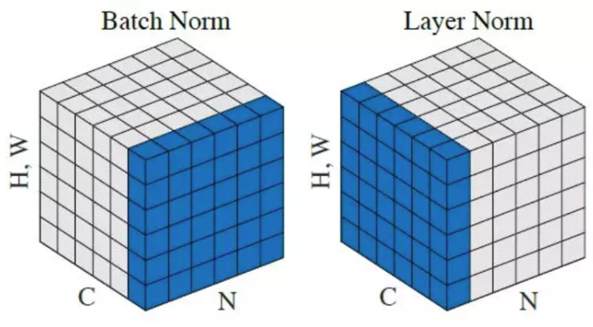
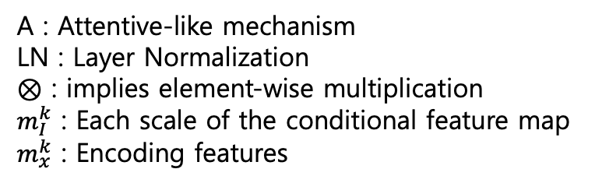
Method Dynamic Conditional Encoding
Details
Architecture : U-Net (from vanilla DPM)

Slide 12
Method Dynamic Conditional Encoding
Details
: 입력데이터와 이전 노이즈가 낀 Segmentation Mask 와 중요한 부분을 고려
: 입력 데이터 피쳐에서 중요한 부분을 얼마나 남길지 연산

Slide 13


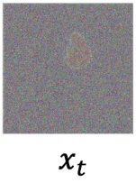
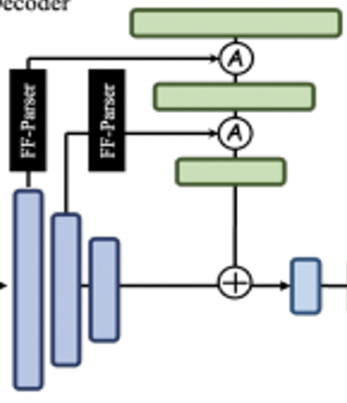


Method Dynamic Conditional Encoding
Another specific problem
The negative effects of high-frequency components
2D FFT
* Multiplying Attentive Map
- A is parameterized
Inverse FFT
segmentation mask
(With high frequency)

Slide 14
Method FF-Parser
2D FFT
* Multiplying Attentive Map
- A is parameterized
Inverse FFT

Slide 15
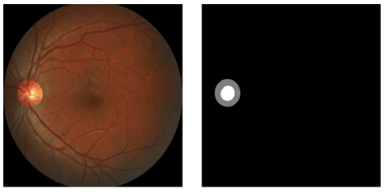
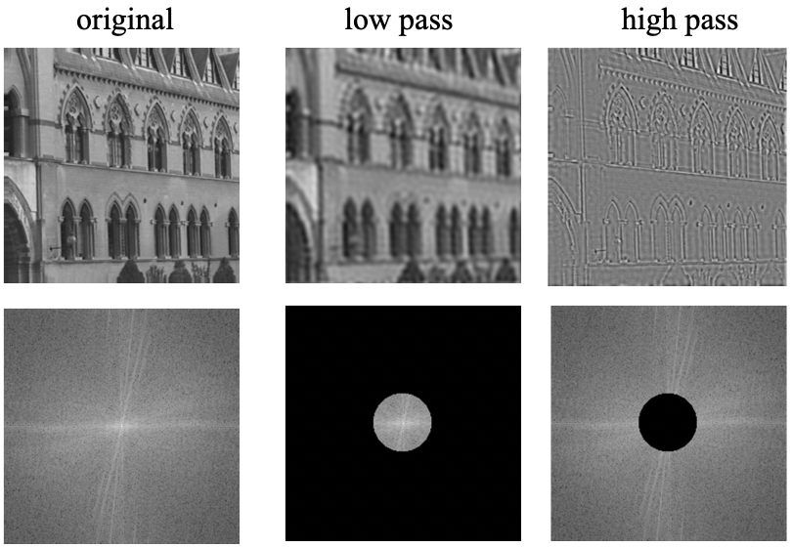
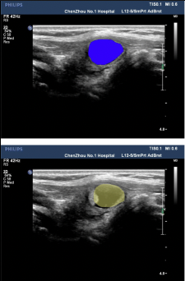
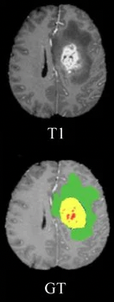
Method FF-Parser
Filtering high frequency
* Medical Datasets
REFUGE-2
BraTs
DDTI

Slide 16
Q & A

Slide 17
Experiments
01 Dataset
02 Main Results
03 Ablation Study

Slide 18
Experiments Datasets
REFUGE-2
1200 samples
Segmentation of Optic Disc and Cup
BraTs
2000 samples
Brain Tumor MRI dataset
DDTI
8046 samples
Thyroid Ultrasound Images
(갑상선 초음파)

Slide 19
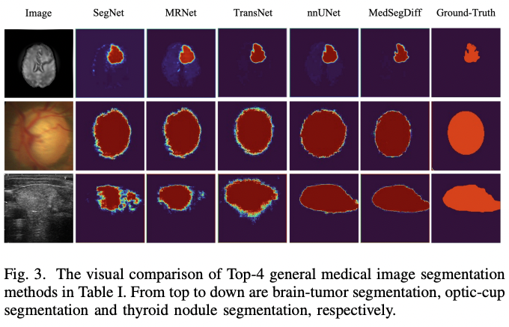
Experiments Main Results

Slide 20
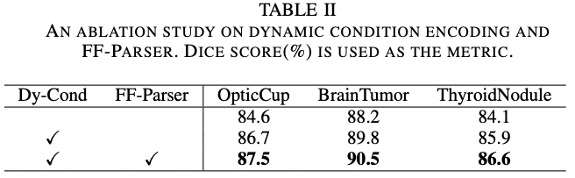
Experiments Ablation Study

Slide 21
Conclusion
We provided a scheme to adopt DPM to the t=general medical image segmentation tasks
We proposed the dynamic conditional encoding and FF-Parser
Out model outperforms previous SOTA
The first DPM application in general medical image segmentation

Slide 22
Q & A

